Slide 1



A new multichannel radiochromic film dosimetry method using Bayesian estimation techniques
A.D. Dominguez-Muñoz^{*1}, H. Miras², M.I. Gallardo¹
¹Universidad de Sevilla (Seville, Spain) ²Hospital Universitario Virgen Macarena (HUVM, Seville)
XXXVII Reunión Bienal de la Real Sociedad Española de Física
Zaragoza, Spain, July 15th-19th 2019
*e-mail: adominguez18@us.es

Slide 2



Outline
The EBT3 radiochromic film
Calibration procedure
A new Bayesian multichannel method
Preliminary results
Conclusions and future work
XXXVII Reunión Bienal de la RSEF
Zaragoza, Spain, July 15th-19th 2019
0

Slide 3
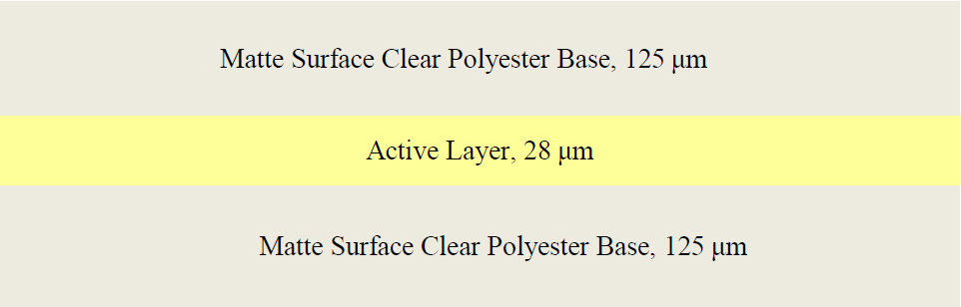
The EBT3 radiochromic film
Technical features
Estructure of GAFChromic EBT3 Dosimetry Film
- Optimum dose range: 0.2 Gy to 10 Gy
- Near tissue equivalent
- Energy-dependence: minimal response difference from 100keV into the MV range
XXXVII Reunión Bienal de la RSEF
Zaragoza, Spain, July 15th-19th 2019
1

Slide 4
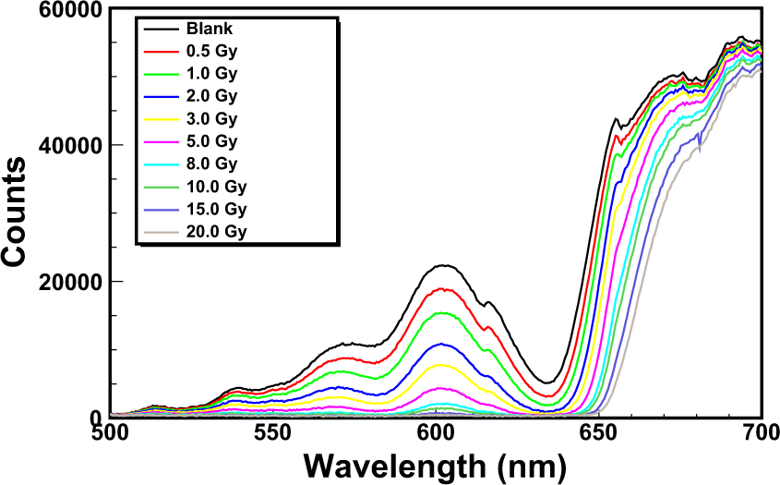
The EBT3 radiochromic film
Technical features
Estructure of GAFChromic EBT3 Dosimetry Film
- Optimum dose range: 0.2 Gy to 10 Gy
- Near tissue equivalent
- Energy-dependence: minimal response difference from 100keV into the MV range
Taken from
[ P. Casolaro et al / Scientific Reports volume 9, Article number: 5307 (2019)]
Spectra of an EBT3 Gafchromic film exposed to ⁶⁰Co gamma-rays from the HDR-irradiator
Dose
Absorbance
XXXVII Reunión Bienal de la RSEF
Zaragoza, Spain, July 15th-19th 2019
1

Slide 5

Calibration procedure
Homogeneous irradiation of film strips with known doses
Image acquisition using a flatbed colour scanner
Film analysis in the three (R,G,B) colour channels (*)
Films irradiated with standard clinical 6 MV X-ray fields at HUVM in Seville
LOT 1
(*) Analysis made using self-developed codes with
XXXVII Reunión Bienal de la RSEF
Zaragoza, Spain, July 15th-19th 2019
2

Slide 6
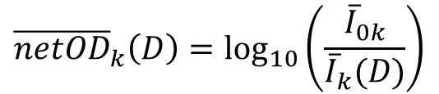
Calibration procedure
Homogeneous irradiation of film strips with known doses
Image acquisition using a flatbed colour scanner
Film analysis in the three (R,G,B) colour channels (*)
Net Optical Density (netOD_{k})
$${\overline{netOD}}_{k}\left(D\right)=\log_{10}\left(\frac{{\overline{I}}_{0k}}{{\overline{I}}_{k}(D)}\right)$$
k ≡ colour cannel (R,G,B)
Films irradiated with standard clinical 6 MV X-ray fields at HUVM in Seville
LOT 1
(*) Analysis made using self-developed codes with
XXXVII Reunión Bienal de la RSEF
Zaragoza, Spain, July 15th-19th 2019
2

Slide 7
Calibration procedure
Homogeneous irradiation of film strips with known doses
Image acquisition using a flatbed colour scanner
Film analysis in the three (R,G,B) colour channels (*)
Net Optical Density (netOD_{k})
$${\overline{netOD}}_{k}\left(D\right)=\log_{10}\left(\frac{{\overline{I}}_{0k}}{{\overline{I}}_{k}(D)}\right)$$
k ≡ colour cannel (R,G,B)
Films irradiated with standard clinical 6 MV X-ray fields at HUVM in Seville
LOT 1
(*) Analysis made using self-developed codes with
XXXVII Reunión Bienal de la RSEF
Zaragoza, Spain, July 15th-19th 2019
2

Slide 8
Calibration procedure
Homogeneous irradiation of film strips with known doses
Image acquisition using a flatbed colour scanner
Film analysis in the three (R,G,B) colour channels (*)
·
·
·
Net Optical Density (netOD_{k})
$${\overline{netOD}}_{k}\left(D\right)=\log_{10}\left(\frac{{\overline{I}}_{0k}}{{\overline{I}}_{k}(D)}\right)$$
k ≡ colour cannel (R,G,B)
Films irradiated with standard clinical 6 MV X-ray fields at HUVM in Seville
LOT 1
(*) Analysis made using self-developed codes with
XXXVII Reunión Bienal de la RSEF
Zaragoza, Spain, July 15th-19th 2019
2

Slide 9
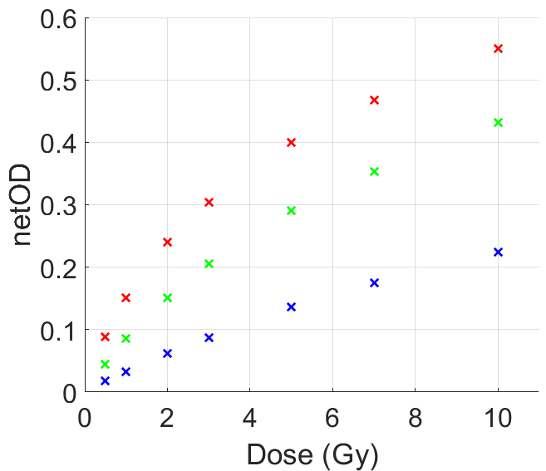
Calibration procedure
Homogeneous irradiation of film strips with known doses
Image acquisition using a flatbed colour scanner
Film analysis in the three (R,G,B) colour channels (*)
Net Optical Density (netOD_{k})
$${\overline{netOD}}_{k}\left(D\right)=\log_{10}\left(\frac{{\overline{I}}_{0k}}{{\overline{I}}_{k}(D)}\right)$$
k ≡ colour cannel (R,G,B)
Films irradiated with standard clinical 6 MV X-ray fields at HUVM in Seville
LOT 1
(*) Analysis made using self-developed codes with
XXXVII Reunión Bienal de la RSEF
Zaragoza, Spain, July 15th-19th 2019
2

Slide 10
Calibration procedure
Calibration curve
$$D_{cal}=b_{k}·{\overline{netOD}}_{k}+c_{k}·{\overline{netOD}}_{k}^{n_{k}}$$
XXXVII Reunión Bienal de la RSEF
Zaragoza, Spain, July 15th-19th 2019
3

Slide 11
Calibration procedure
Calibration curve
$$D_{cal}=b_{k}·{\overline{netOD}}_{k}+c_{k}·{\overline{netOD}}_{k}^{n_{k}}$$
No analytical inverse!!
XXXVII Reunión Bienal de la RSEF
Zaragoza, Spain, July 15th-19th 2019
3

Slide 12
Calibration procedure
Calibration curve
$$D_{cal}=b_{k}·{\overline{netOD}}_{k}+c_{k}·{\overline{netOD}}_{k}^{n_{k}}$$
No analytical inverse!!
XXXVII Reunión Bienal de la RSEF
Zaragoza, Spain, July 15th-19th 2019
3

Slide 13
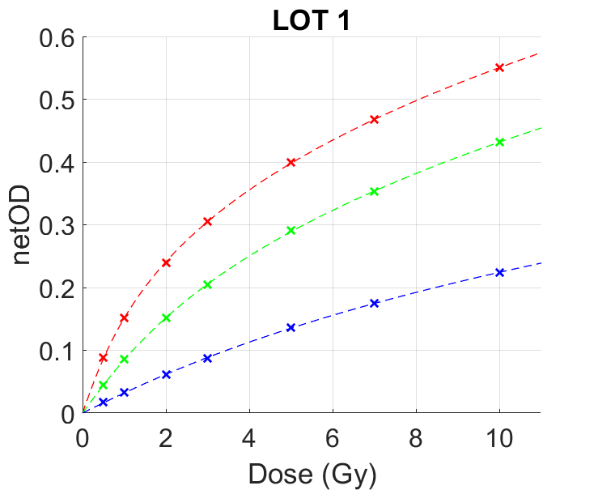
Calibration procedure
Calibration curve
$$D_{cal}=b_{k}·{\overline{netOD}}_{k}+c_{k}·{\overline{netOD}}_{k}^{n_{k}}$$
No analytical inverse!!
XXXVII Reunión Bienal de la RSEF
Zaragoza, Spain, July 15th-19th 2019
3

Slide 14
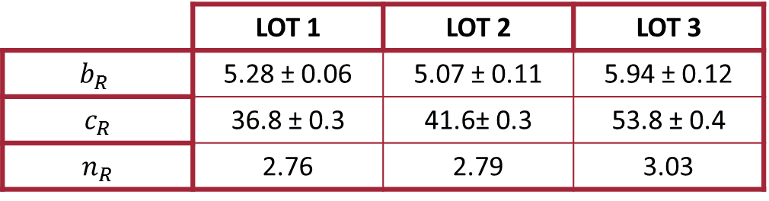
Calibration procedure
Calibration curve
$$D_{cal}=b_{k}·{\overline{netOD}}_{k}+c_{k}·{\overline{netOD}}_{k}^{n_{k}}$$
No analytical inverse!!
( + different scanner)
Red channel
 | LOT 1 | LOT 2 | LOT 3
$$b_{R}$$ | 5.28 ± 0.06 | 5.07 ± 0.11 | 5.94 ± 0.12
$$c_{R}$$ | 36.8 ± 0.3 | 41.6± 0.3 | 53.8 ± 0.4
$$n_{R}$$ | 2.76 | 2.79 | 3.03
The lowest parameter uncertainties obtained !!
XXXVII Reunión Bienal de la RSEF
Zaragoza, Spain, July 15th-19th 2019
3

Slide 15
Calibration procedure
Calibration curve
$$D_{cal}=b_{k}·{\overline{netOD}}_{k}+c_{k}·{\overline{netOD}}_{k}^{n_{k}}$$
No analytical inverse!!
( + different scanner)
Red channel
 | LOT 1 | LOT 2 | LOT 3
$$b_{R}$$ | 5.28 ± 0.06 | 5.07 ± 0.11 | 5.94 ± 0.12
$$c_{R}$$ | 36.8 ± 0.3 | 41.6± 0.3 | 53.8 ± 0.4
$$n_{R}$$ | 2.76 | 2.79 | 3.03
X-Rays
The lowest parameter uncertainties obtained !!
Protons:
[ M.C. Battaglia et al.
Nuclear Inst. and Methods in Physics Research B 444 (2019) 117–124]
XXXVII Reunión Bienal de la RSEF
Zaragoza, Spain, July 15th-19th 2019
3

Slide 16
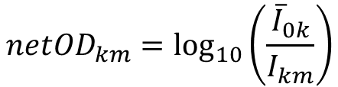
A new Bayesian multichannel method
Pixel dose from calibration curve
$$D_{km}=b_{k}·{netOD}_{km}+c_{k}·{netOD}_{km}^{n_{k}}$$
k ≡ colour cannel (R,G,B)
m ≡ pixel number
LOT 1
$${netOD}_{km}=\log_{10}\left(\frac{{\overline{I}}_{0k}}{I_{km}}\right)$$
XXXVII Reunión Bienal de la RSEF
Zaragoza, Spain, July 15th-19th 2019
4

Slide 17
A new Bayesian multichannel method
Pixel dose from calibration curve
$$D_{km}=b_{k}·{netOD}_{km}+c_{k}·{netOD}_{km}^{n_{k}}$$
k ≡ colour cannel (R,G,B)
m ≡ pixel number
LOT 1
$${netOD}_{km}=\log_{10}\left(\frac{{\overline{I}}_{0k}}{I_{km}}\right)$$
No pixel information before irradiation !!
XXXVII Reunión Bienal de la RSEF
Zaragoza, Spain, July 15th-19th 2019
4

Slide 18
A new Bayesian multichannel method
Pixel dose from calibration curve
$$D_{km}=b_{k}·{netOD}_{km}+c_{k}·{netOD}_{km}^{n_{k}}$$
k ≡ colour cannel (R,G,B)
m ≡ pixel number
LOT 1
$${netOD}_{km}=\log_{10}\left(\frac{{\overline{I}}_{0k}}{I_{km}}\right)$$
No pixel information before irradiation !!
XXXVII Reunión Bienal de la RSEF
Zaragoza, Spain, July 15th-19th 2019
4

Slide 19
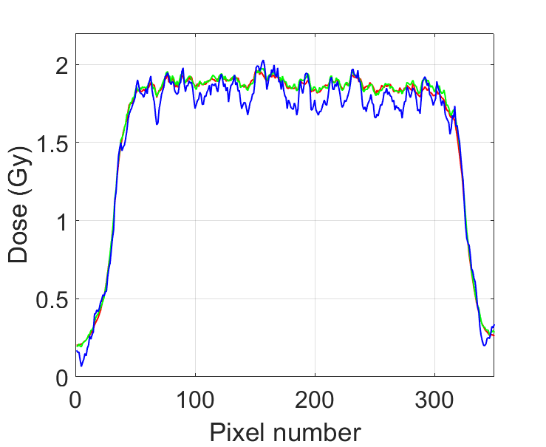
A new Bayesian multichannel method
Pixel dose from calibration curve
$$D_{km}=b_{k}·{netOD}_{km}+c_{k}·{netOD}_{km}^{n_{k}}$$
k ≡ colour cannel (R,G,B)
m ≡ pixel number
LOT 1
$${netOD}_{km}=\log_{10}\left(\frac{{\overline{I}}_{0k}}{I_{km}}\right)$$
No pixel information before irradiation !!
XXXVII Reunión Bienal de la RSEF
Zaragoza, Spain, July 15th-19th 2019
4

Slide 20
A new Bayesian multichannel method
Pixel dose from calibration curve
$$D_{km}=b_{k}·{netOD}_{km}+c_{k}·{netOD}_{km}^{n_{k}}$$
k ≡ colour cannel (R,G,B)
m ≡ pixel number
LOT 1
$${netOD}_{km}=\log_{10}\left(\frac{{\overline{I}}_{0k}}{I_{km}}\right)$$
No pixel information before irradiation !!
XXXVII Reunión Bienal de la RSEF
Zaragoza, Spain, July 15th-19th 2019
4

Slide 21
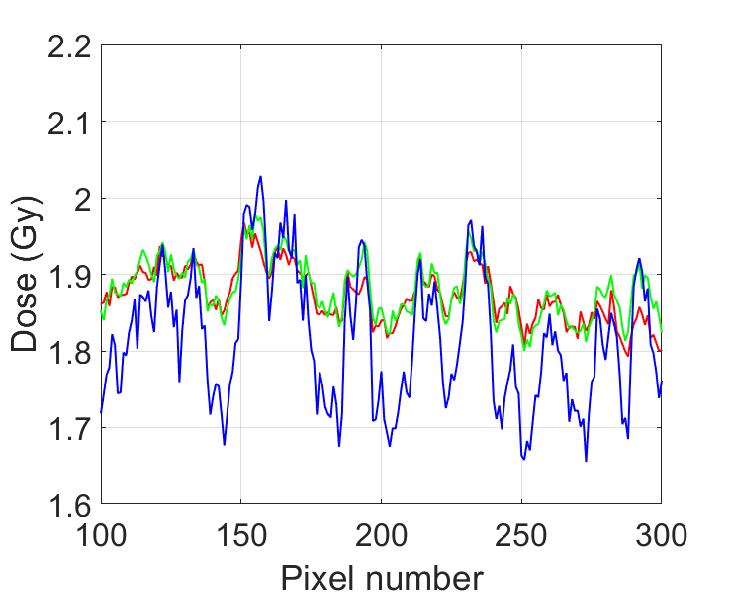
A new Bayesian multichannel method
Pixel dose from calibration curve
$$D_{km}=b_{k}·{netOD}_{km}+c_{k}·{netOD}_{km}^{n_{k}}$$
k ≡ colour cannel (R,G,B)
m ≡ pixel number
LOT 1
Pixel inhomogeneities affect each channel in a different way
$${netOD}_{km}=\log_{10}\left(\frac{{\overline{I}}_{0k}}{I_{km}}\right)$$
No pixel information before irradiation !!
XXXVII Reunión Bienal de la RSEF
Zaragoza, Spain, July 15th-19th 2019
4

Slide 22
A new Bayesian multichannel method
Pixel dose from calibration curve
$$D_{km}=b_{k}·{netOD}_{km}+c_{k}·{netOD}_{km}^{n_{k}}$$
k ≡ colour cannel (R,G,B)
m ≡ pixel number
XXXVII Reunión Bienal de la RSEF
Zaragoza, Spain, July 15th-19th 2019
4

Slide 23
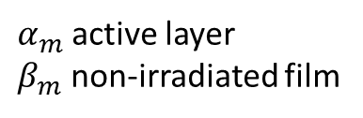
A new Bayesian multichannel method
Pixel dose from calibration curve
$$D_{km}=b_{k}·{netOD}_{km}+c_{k}·{netOD}_{km}^{n_{k}}$$
k ≡ colour cannel (R,G,B)
m ≡ pixel number
Pixel inhomogeneities parameters
$α_{m}$ active layer
$β_{m}$ non-irradiated film
XXXVII Reunión Bienal de la RSEF
Zaragoza, Spain, July 15th-19th 2019
4

Slide 24
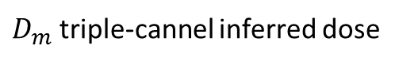
A new Bayesian multichannel method
Pixel dose from calibration curve
$$D_{km}=b_{k}·{netOD}_{km}+c_{k}·{netOD}_{km}^{n_{k}}$$
k ≡ colour cannel (R,G,B)
m ≡ pixel number
Pixel inhomogeneities parameters
$α_{m}$ active layer
$β_{m}$ non-irradiated film
$$∆{netOD}_{km}=∆{netOD}_{km}(D_{m},α_{m},β_{m})$$
$D_{m}$ triple-cannel inferred dose
XXXVII Reunión Bienal de la RSEF
Zaragoza, Spain, July 15th-19th 2019
4

Slide 25
A new Bayesian multichannel method
Pixel dose from calibration curve
$$D_{km}=b_{k}·{netOD}_{km}+c_{k}·{netOD}_{km}^{n_{k}}$$
k ≡ colour cannel (R,G,B)
m ≡ pixel number
Model based on Beer-Lambert Law
Pixel inhomogeneities parameters
$α_{m}$ active layer
$β_{m}$ non-irradiated film
$$∆{netOD}_{km}=∆{netOD}_{km}(D_{m},α_{m},β_{m})$$
$D_{m}$ triple-cannel inferred dose
Dose-independent inhomogeneities parameters!!
XXXVII Reunión Bienal de la RSEF
Zaragoza, Spain, July 15th-19th 2019
4

Slide 26
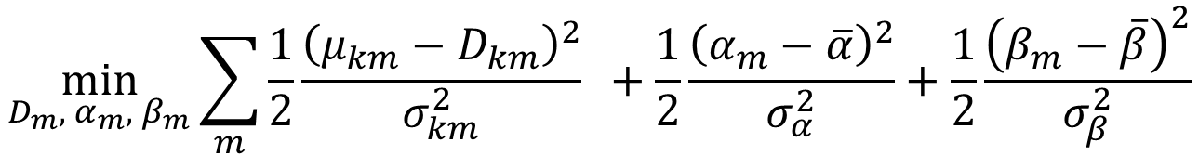
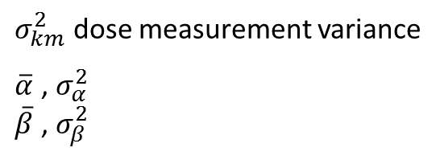
A new Bayesian multichannel method
Pixel dose from calibration curve
$$D_{km}=b_{k}·{netOD}_{km}+c_{k}·{netOD}_{km}^{n_{k}}$$
k ≡ colour cannel (R,G,B)
m ≡ pixel number
Model based on Beer-Lambert Law
Pixel inhomogeneities parameters
$α_{m}$ active layer
$β_{m}$ non-irradiated film
$$∆{netOD}_{km}=∆{netOD}_{km}(D_{m},α_{m},β_{m})$$
$D_{m}$ triple-cannel inferred dose
Dose-independent inhomogeneities parameters!!
Maximum a posteriori estimation
Normal distribution
$$\min_{D_{m}, α_{m}, β_{m}}\sum_{m}{\frac{1}{2}\frac{{\left(μ_{km}−D_{km}\right)}^{2}}{σ_{km}^{2}}}{ }+\frac{1}{2}\frac{{\left(α_{m}−\overline{α}\right)}^{2}}{σ_{α}^{2}}+\frac{1}{2}\frac{{\left(β_{m}−\overline{β}\right)}^{2}}{σ_{β}^{2}}$$
$σ_{km}^{2}$ dose measurement variance
$\overline{α}$ , $σ_{α}^{2}$
$\overline{β}$ , $σ_{β}^{2}$
inhomogeneities hyperparameters
likelihood
priori
XXXVII Reunión Bienal de la RSEF
Zaragoza, Spain, July 15th-19th 2019
4

Slide 27
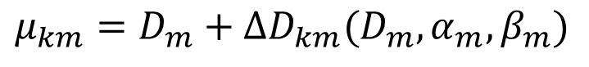
A new Bayesian multichannel method
Pixel dose from calibration curve
$$D_{km}=b_{k}·{netOD}_{km}+c_{k}·{netOD}_{km}^{n_{k}}$$
k ≡ colour cannel (R,G,B)
m ≡ pixel number
Model based on Beer-Lambert Law
Pixel inhomogeneities parameters
$α_{m}$ active layer
$β_{m}$ non-irradiated film
$$∆{netOD}_{km}=∆{netOD}_{km}(D_{m},α_{m},β_{m})$$
$D_{m}$ triple-cannel inferred dose
Dose-independent inhomogeneities parameters!!
Maximum a posteriori estimation
Normal distribution
$$\min_{D_{m}, α_{m}, β_{m}}\sum_{m}{\frac{1}{2}\frac{{\left(μ_{km}−D_{km}\right)}^{2}}{σ_{km}^{2}}}{ }+\frac{1}{2}\frac{{\left(α_{m}−\overline{α}\right)}^{2}}{σ_{α}^{2}}+\frac{1}{2}\frac{{\left(β_{m}−\overline{β}\right)}^{2}}{σ_{β}^{2}}$$
$σ_{km}^{2}$ dose measurement variance
$\overline{α}$ , $σ_{α}^{2}$
$\overline{β}$ , $σ_{β}^{2}$
inhomogeneities hyperparameters
likelihood
priori
$$μ_{km}=D_{m}+∆D_{km}(D_{m},α_{m},β_{m})$$
$$∆D_{km}(D_{m},α_{m},β_{m})∝∆{netOD}_{km}(D_{m},α_{m},β_{m})$$
Perturbation theory
XXXVII Reunión Bienal de la RSEF
Zaragoza, Spain, July 15th-19th 2019
4

Slide 28
A new Bayesian multichannel method
Pixel dose from calibration curve
$$D_{km}=b_{k}·{netOD}_{km}+c_{k}·{netOD}_{km}^{n_{k}}$$
k ≡ colour cannel (R,G,B)
m ≡ pixel number
Model based on Beer-Lambert Law
Pixel inhomogeneities parameters
$α_{m}$ active layer
$β_{m}$ non-irradiated film
$$∆{netOD}_{km}=∆{netOD}_{km}(D_{m},α_{m},β_{m})$$
$D_{m}$ triple-cannel inferred dose
Dose-independent inhomogeneities parameters!!
Maximum a posteriori estimation
Normal distribution
$$\min_{D_{m}, α_{m}, β_{m}}\sum_{m}{\frac{1}{2}\frac{{\left(μ_{km}−D_{km}\right)}^{2}}{σ_{km}^{2}}}{ }+\frac{1}{2}\frac{{\left(α_{m}−\overline{α}\right)}^{2}}{σ_{α}^{2}}+\frac{1}{2}\frac{{\left(β_{m}−\overline{β}\right)}^{2}}{σ_{β}^{2}}$$
$σ_{km}^{2}$ dose measurement variance
$\overline{α}$ , $σ_{α}^{2}$
$\overline{β}$ , $σ_{β}^{2}$
inhomogeneities hyperparameters
likelihood
priori
Weighted least squares!!
More information extracted from calibration data!!
$$μ_{km}=D_{m}+∆D_{km}(D_{m},α_{m},β_{m})$$
$$∆D_{km}(D_{m},α_{m},β_{m})∝∆{netOD}_{km}(D_{m},α_{m},β_{m})$$
Perturbation theory
XXXVII Reunión Bienal de la RSEF
Zaragoza, Spain, July 15th-19th 2019
4

Slide 29
Preliminary results
XXXVII Reunión Bienal de la RSEF
Zaragoza, Spain, July 15th-19th 2019
5

Slide 30
Preliminary results
X-Rays
XXXVII Reunión Bienal de la RSEF
Zaragoza, Spain, July 15th-19th 2019
5

Slide 31
Preliminary results
X-Rays
A priori distribution effect
XXXVII Reunión Bienal de la RSEF
Zaragoza, Spain, July 15th-19th 2019
5

Slide 32
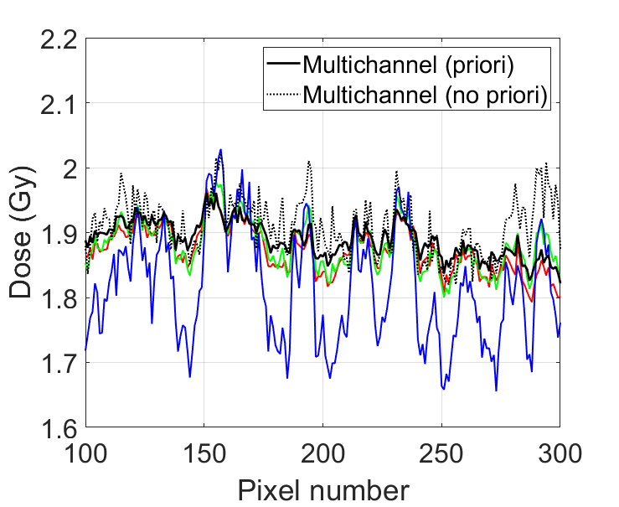
Preliminary results
X-Rays
A priori distribution effect
Less variation with priori information!!
XXXVII Reunión Bienal de la RSEF
Zaragoza, Spain, July 15th-19th 2019
5

Slide 33
Preliminary results
X-Rays
Dose independence of parameters
XXXVII Reunión Bienal de la RSEF
Zaragoza, Spain, July 15th-19th 2019
7

Slide 34
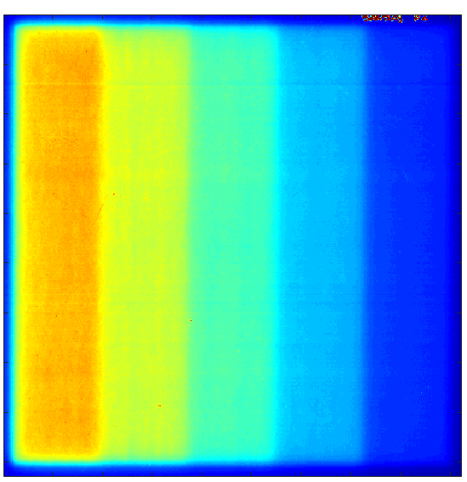
Preliminary results
X-Rays
Dose independence of parameters
XXXVII Reunión Bienal de la RSEF
Zaragoza, Spain, July 15th-19th 2019
7

Slide 35
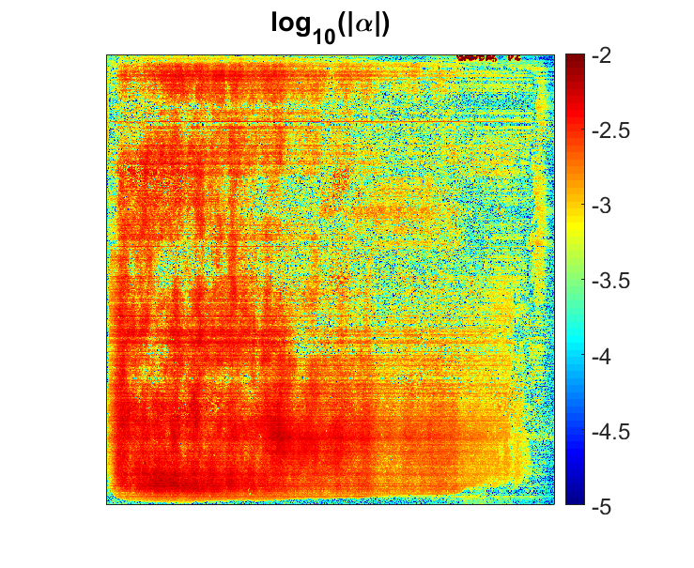
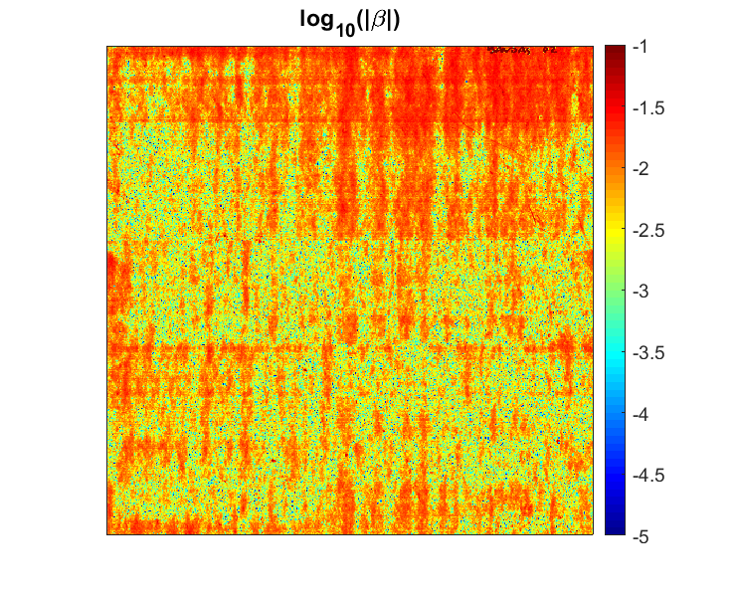
Preliminary results
X-Rays
Dose independence of parameters
XXXVII Reunión Bienal de la RSEF
Zaragoza, Spain, July 15th-19th 2019
7

Slide 36
Preliminary results
X-Rays
Validation: Gamma Analysis
Criteria: 4cGy-2mm
Gamma < 1% - 90.73%
XXXVII Reunión Bienal de la RSEF
Zaragoza, Spain, July 15th-19th 2019
8

Slide 37
Preliminary results
X-Rays
Validation: Gamma Analysis
Criteria: 4cGy-2mm
Gamma < 1% - 90.73%
Scanner lateral artefacts
XXXVII Reunión Bienal de la RSEF
Zaragoza, Spain, July 15th-19th 2019
8

Slide 38
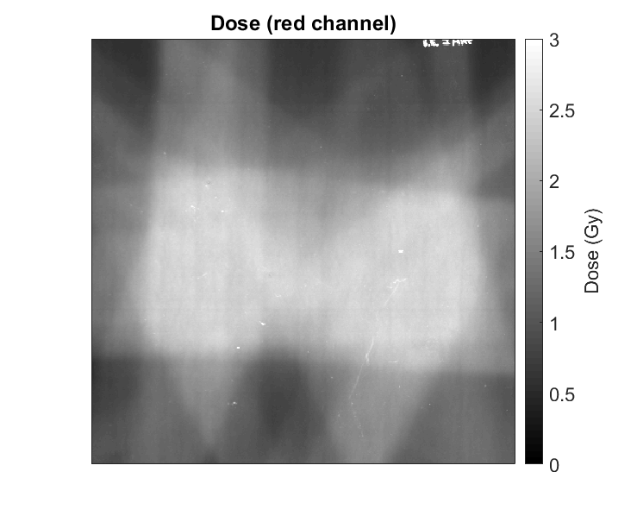
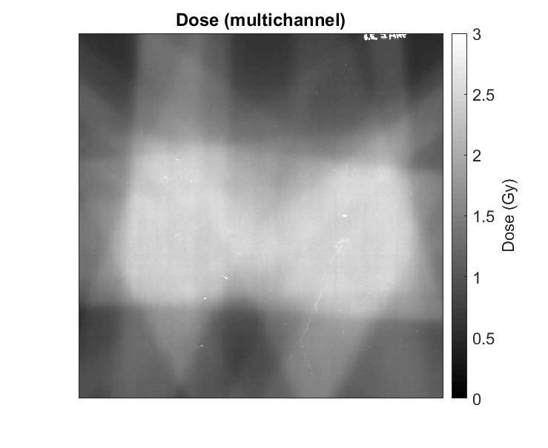
Preliminary results
X-Rays
IMRT plan verification
XXXVII Reunión Bienal de la RSEF
Zaragoza, Spain, July 15th-19th 2019
9

Slide 39
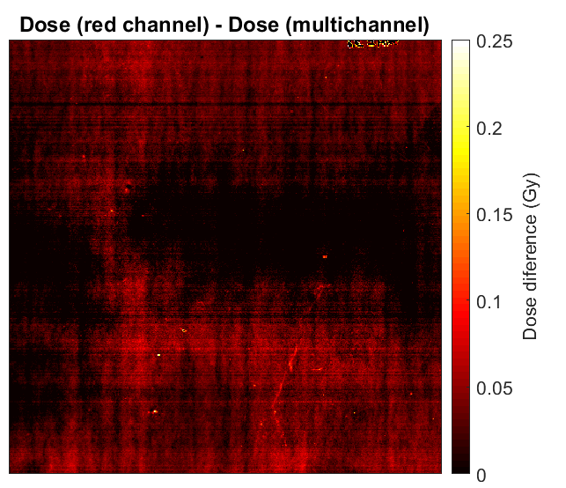
Preliminary results
X-Rays
IMRT plan verification
XXXVII Reunión Bienal de la RSEF
Zaragoza, Spain, July 15th-19th 2019
9

Slide 40
Preliminary results
X-Rays
IMRT plan verification
Major correction in damaged pixels !!
XXXVII Reunión Bienal de la RSEF
Zaragoza, Spain, July 15th-19th 2019
9

Slide 41
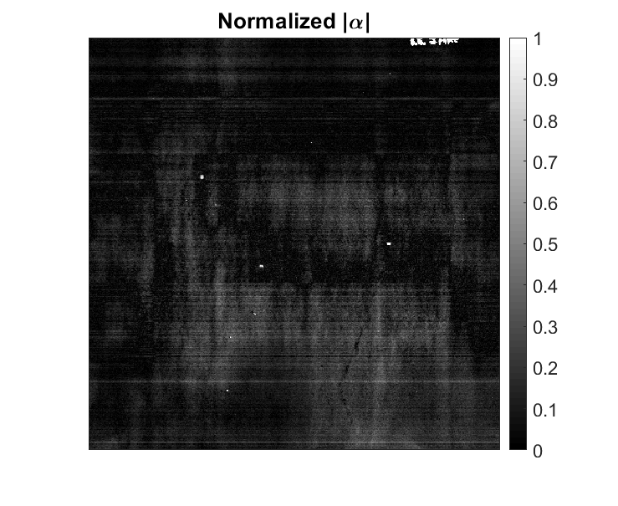
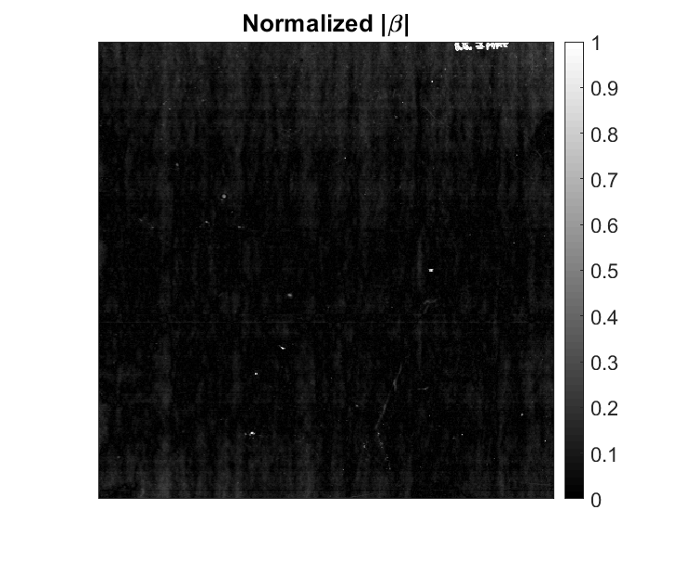
Preliminary results
X-Rays
IMRT plan verification
XXXVII Reunión Bienal de la RSEF
Zaragoza, Spain, July 15th-19th 2019
10

Slide 42
Preliminary results
X-Rays
IMRT plan verification
Deep damage
Deep damage
XXXVII Reunión Bienal de la RSEF
Zaragoza, Spain, July 15th-19th 2019
10

Slide 43
Preliminary results
X-Rays
IMRT plan verification
Deep damage
Deep damage
Superficial damage
Superficial damage
XXXVII Reunión Bienal de la RSEF
Zaragoza, Spain, July 15th-19th 2019
10

Slide 44
Conclusions and future work
Multichannel methods are necessary to obtain a unique value of the dose from the scanned image together with the calibration curve.
Our multichannel method introduces the next news:
Use of a calibration curve with non-analytic inverse
Weighted least squares by experimental uncertainty of measured pixel
Dose independent inhomogeneities parameters
Addition of priori information extracted from calibration data
Results shows a good agreement with TPS calculation.
Major correction is made in damaged zones and with strong inhomogeneities.
Comparison between inhomogeneites parameters can give us an idea about its type.
The next step is to apply this technique to low energy proton radiotherapy dosimetry, in which we expected that it plays an important role.
XXXVII Reunión Bienal de la RSEF
Zaragoza, Spain, July 15th-19th 2019
11

